Slide 1
Executive Summary
The Police Commissioner of the UK strives to provide a safe and efficient transport system and make roads safer for all the people. For that it is really very important to understand the transportation data provided by the Department of Transport of the UK and recognize the severity of the accidents and factors affecting the severity.
According to the data it is seen that the maximum number of accidents happen in the daylight, fine no high winds and Dry conditions. Considering the severity of accidents, the graph looks more inclined towards urban areas as compared to rural areas. Single carriageway road type has the highest number of accidents. The majority of the accident cases were inspected by a police authority. There was no particular pattern observed for accidents occurring at time of the day or any day of the week.

Slide 2
Severity of accident depending upon the following -
The accident severity in the light conditions has been seen mostly happening in the daylight followed by darkness with the lights lit. Ironically majority of the accidents occur in fine with no high wind condition, raining with no high winds is another condition where accidents are occurred but there is huge difference in the ratio of number of accidents occurred in both conditions. Accidents depending on the seasonality does not make any difference as the average accidents are same any time, any day of the week.
The predictors of accident severity are as follows: 1. light conditions – day light 2. weather conditions – Fine no high winds 3.Road surface conditions – Dry 4. By location – Urban 5. Road type- Single carriageway
The police attended majority of the accidents occurred amongst which 5% were fatal, 15% were serious and 80% were slight.

Slide 3
Analysis Process
Followed the entire data lifecycle stages and performed the Data analysis accordingly.
Collected the data from the Department of Transport of UK.
Checked and eradicated if there are any missing or null values.
After cleaning the data, imported the data into Tableau for the further analysis.
To measure the accident severity on different factor, I chose to plot graph on light condition, weather condition, road surface condition, road type.
Considering the factor of longitude and latitude I plotted a map graph showing the count of accident severity depending upon accident location.

Slide 4
Observing the accident, built the graph on accident severity in Urban and Rural areas.
Also monitored if the police have attended the accident scene in urban or rural areas.
Depending on the location checked how many police forces are there in that particular location.
Plotting a map graph analyzed if the police attended the carriageway hazard.
Link to Tableau Public – Accident Severity Analysis

Slide 5
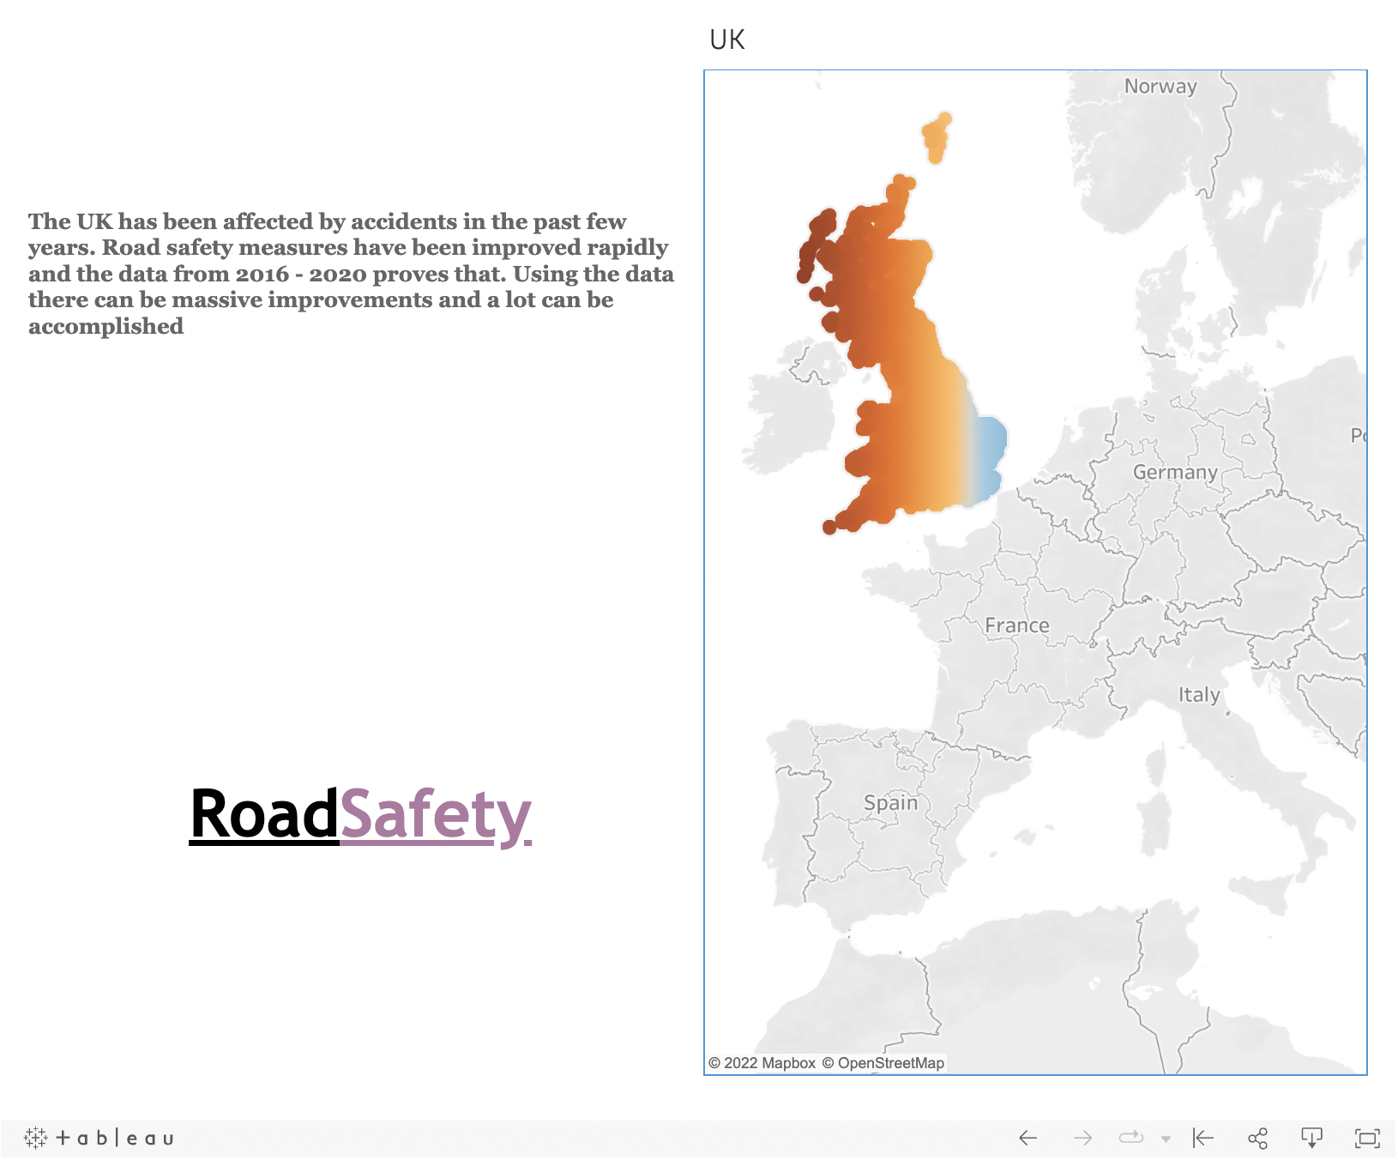

Slide 6
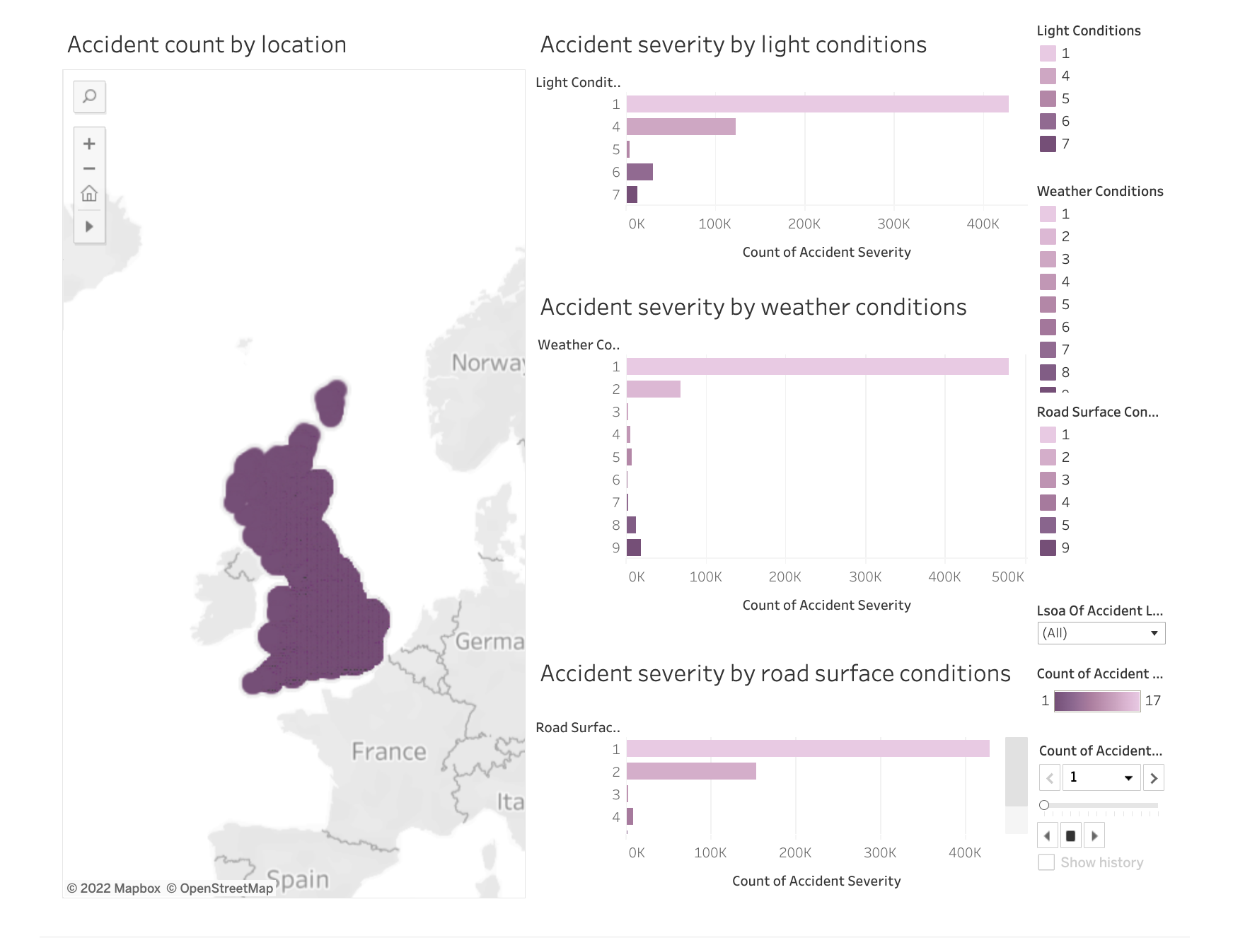

Slide 7
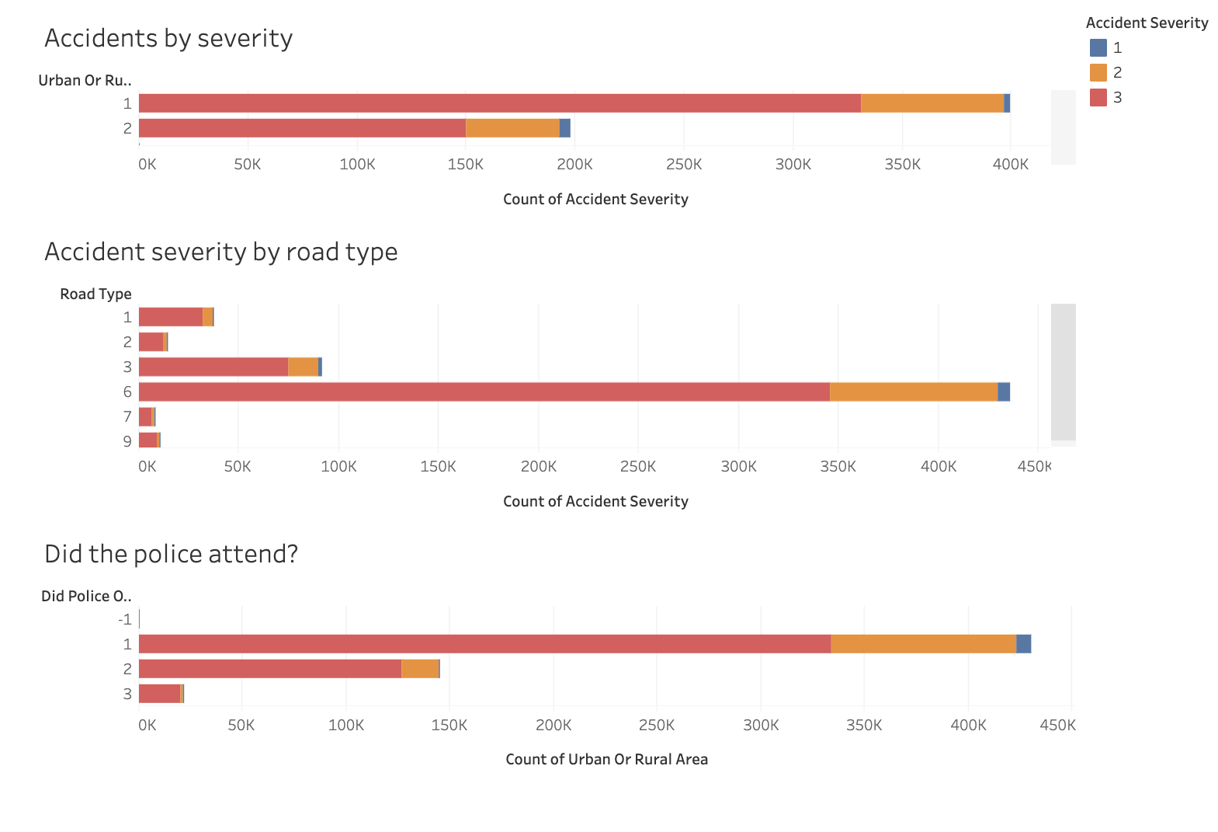

Slide 8
